Slide 1
Guide to Computer Forensics and Investigations Sixth Edition Chapter 8
Recovering Graphics Files
Notes:
Guide to Computer Forensics and Investigations Sixth Edition
Chapter 8
Recovering Graphics Files

Slide 2
Objectives
Describe types of graphics file formats
Explain types of data compression
Explain how to locate and recover graphics files
Describe how to identify unknown file formats
Explain copyright issues with graphics

Slide 3
Recognizing a Graphics File
Graphic files contain digital photographs, line art, three-dimensional images, text data converted to images, and scanned replicas of printed pictures
Bitmap images: collection of dots
Vector graphics: based on mathematical instructions
Metafile graphics: combination of bitmap and vector
Types of programs
Graphics editors
Image viewers

Slide 4


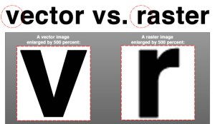
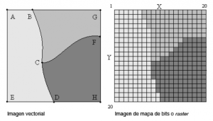
Understanding Bitmap and Raster Images
Bitmap images
Grids of individual pixels
Raster images - also collections of pixels
Pixels are stored in rows
Better for printing
Image quality
Screen resolution - determines amount of detail
Software contributes to image quality (drivers)
Number of color bits used per pixel
https://www.youtube.com/watch?v=p2thSkOa_Xg

Slide 5
Understanding Vector Graphics
Characteristics of vector graphics
Uses lines instead of dots
Store only the calculations for drawing lines and shapes
Smaller than bitmap files
Preserve quality when image is enlarged
Disadvantage
They aren’t too suitable for encoding videos or pictures from the real world. They do support mixed compositions, though.
The data used for describing them needs to be processed by powerful machines. If the volume of data is high, it slows down image rendering even if the files are small in size.
One more disadvantage is that even the smallest of errors in the drawings are visible when you enlarge images to an extent. These incidents can affect image quality, especially when used in animation.
CorelDRAW, Adobe Illustrator

Slide 6
Understanding Metafile Graphics
Metafile graphics combine raster and vector graphics
Example
Scanned photo (bitmap) with text or arrows (vector)
Share advantages and disadvantages of both types
When enlarged, bitmap part loses quality

Slide 7
Understanding Graphics File Formats (1 of 2)
Standard graphics file formats
Standard bitmap file formats
Portable Network Graphic (.png)
Graphic Interchange Format (.gif)
Joint Photographic Experts Group (.jpeg, .jpg)
Tagged Image File Format (.tiff, .tif)
Window Bitmap (.bmp)
Standard vector file formats
Hewlett Packard Graphics Language (.hpgl)
Autocad (.dxf)

Slide 8
Understanding Graphics File Formats (2 of 2)
Nonstandard graphics file formats
Targa (.tga)
Raster Transfer Language (.rtl)
Adobe Photoshop (.psd) and Illustrator (.ai)
Freehand (.fh11)
Scalable Vector Graphics (.svg)
Paintbrush (.pcx)
Search the Web for software to manipulate unknown image formats
www.webopedia.com

Slide 9
Understanding Digital Photograph File Formats (1 of 8)
Witnesses or suspects can create their own digital photos
Examining the raw file format
Raw file format
Referred to as a digital negative
Typically found on many higher-end digital cameras
Sensors in the digital camera simply record pixels on the camera’s memory card
Raw format maintains the best picture quality

Slide 10
Understanding Digital Photograph File Formats (2 of 8)
Examining the raw file format (cont’d)
The biggest disadvantage is that it’s proprietary
And not all image viewers can display these formats
The process of converting raw picture data to another format is referred to as demosaicing
JPEG (loss), TIF (lossless)
Examining the Exchangeable Image File format
Exchangeable Image File (Exif) format
Commonly used to store digital pictures
Developed by JEITA as a standard for storing metadata in JPEG and TIF files, named Exif JPEG, Exit TIF
Device info: Model, maker, serial number
Setting: shutter speed, focal length, resolution, date, time

Slide 11
Understanding Digital Photograph File Formats (3 of 8)
Examining the Exchangeable Image File format (cont’d)
Exif format collects metadata
Investigators can learn more about the type of digital device and the environment in which photos were taken
Viewing an Exif JPEG file’s metadata requires special programs
Exif Reader, IrfanView, or Magnet Forensics AXIOM
Exif file stores metadata at the beginning of the file

Slide 12
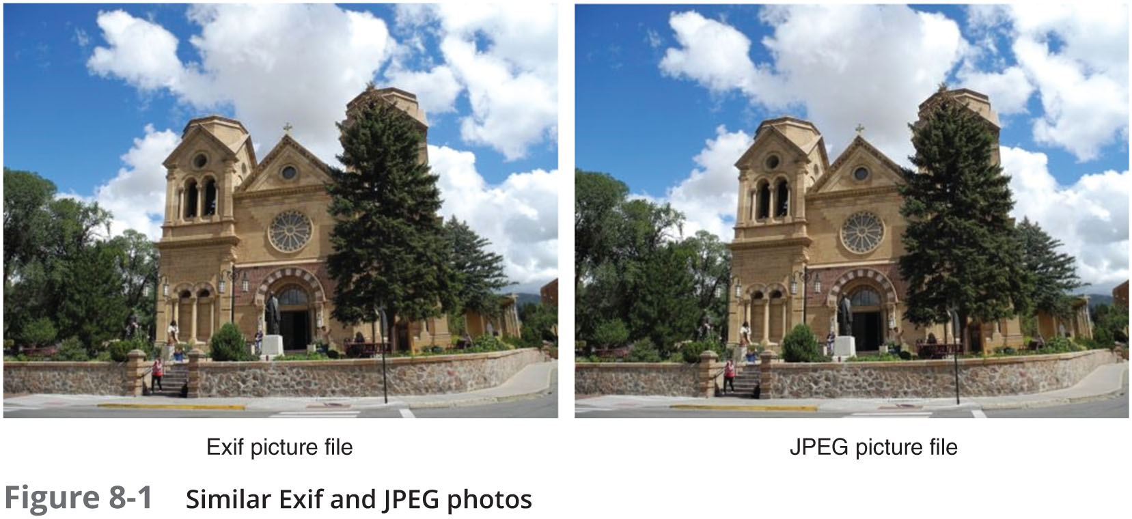
Understanding Digital Photograph File Formats (4 of 8)

Slide 13
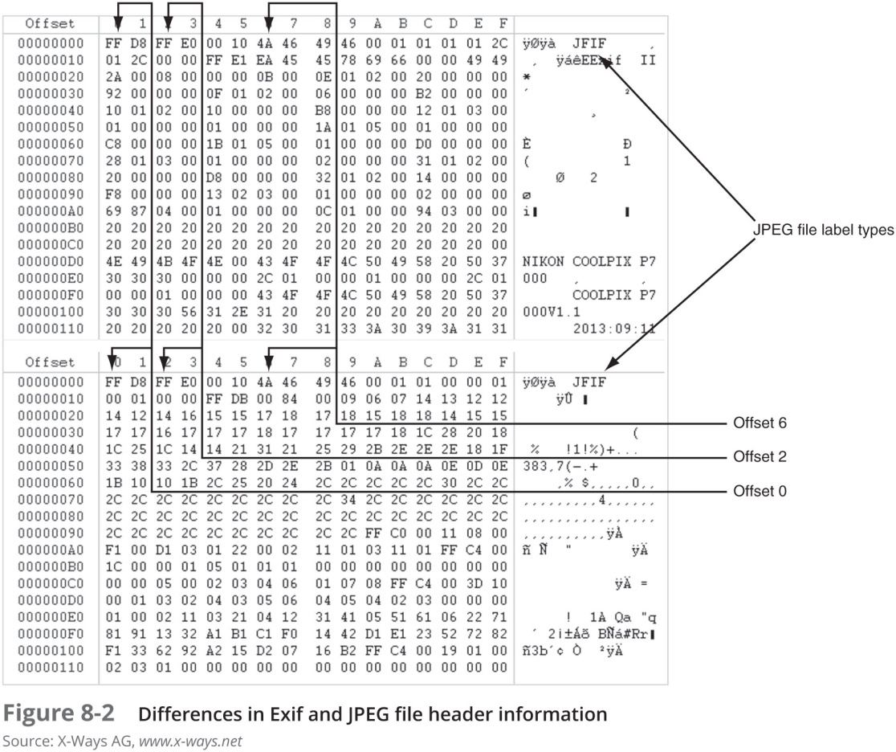
Understanding Digital Photograph File Formats (5 of 8)

Slide 14
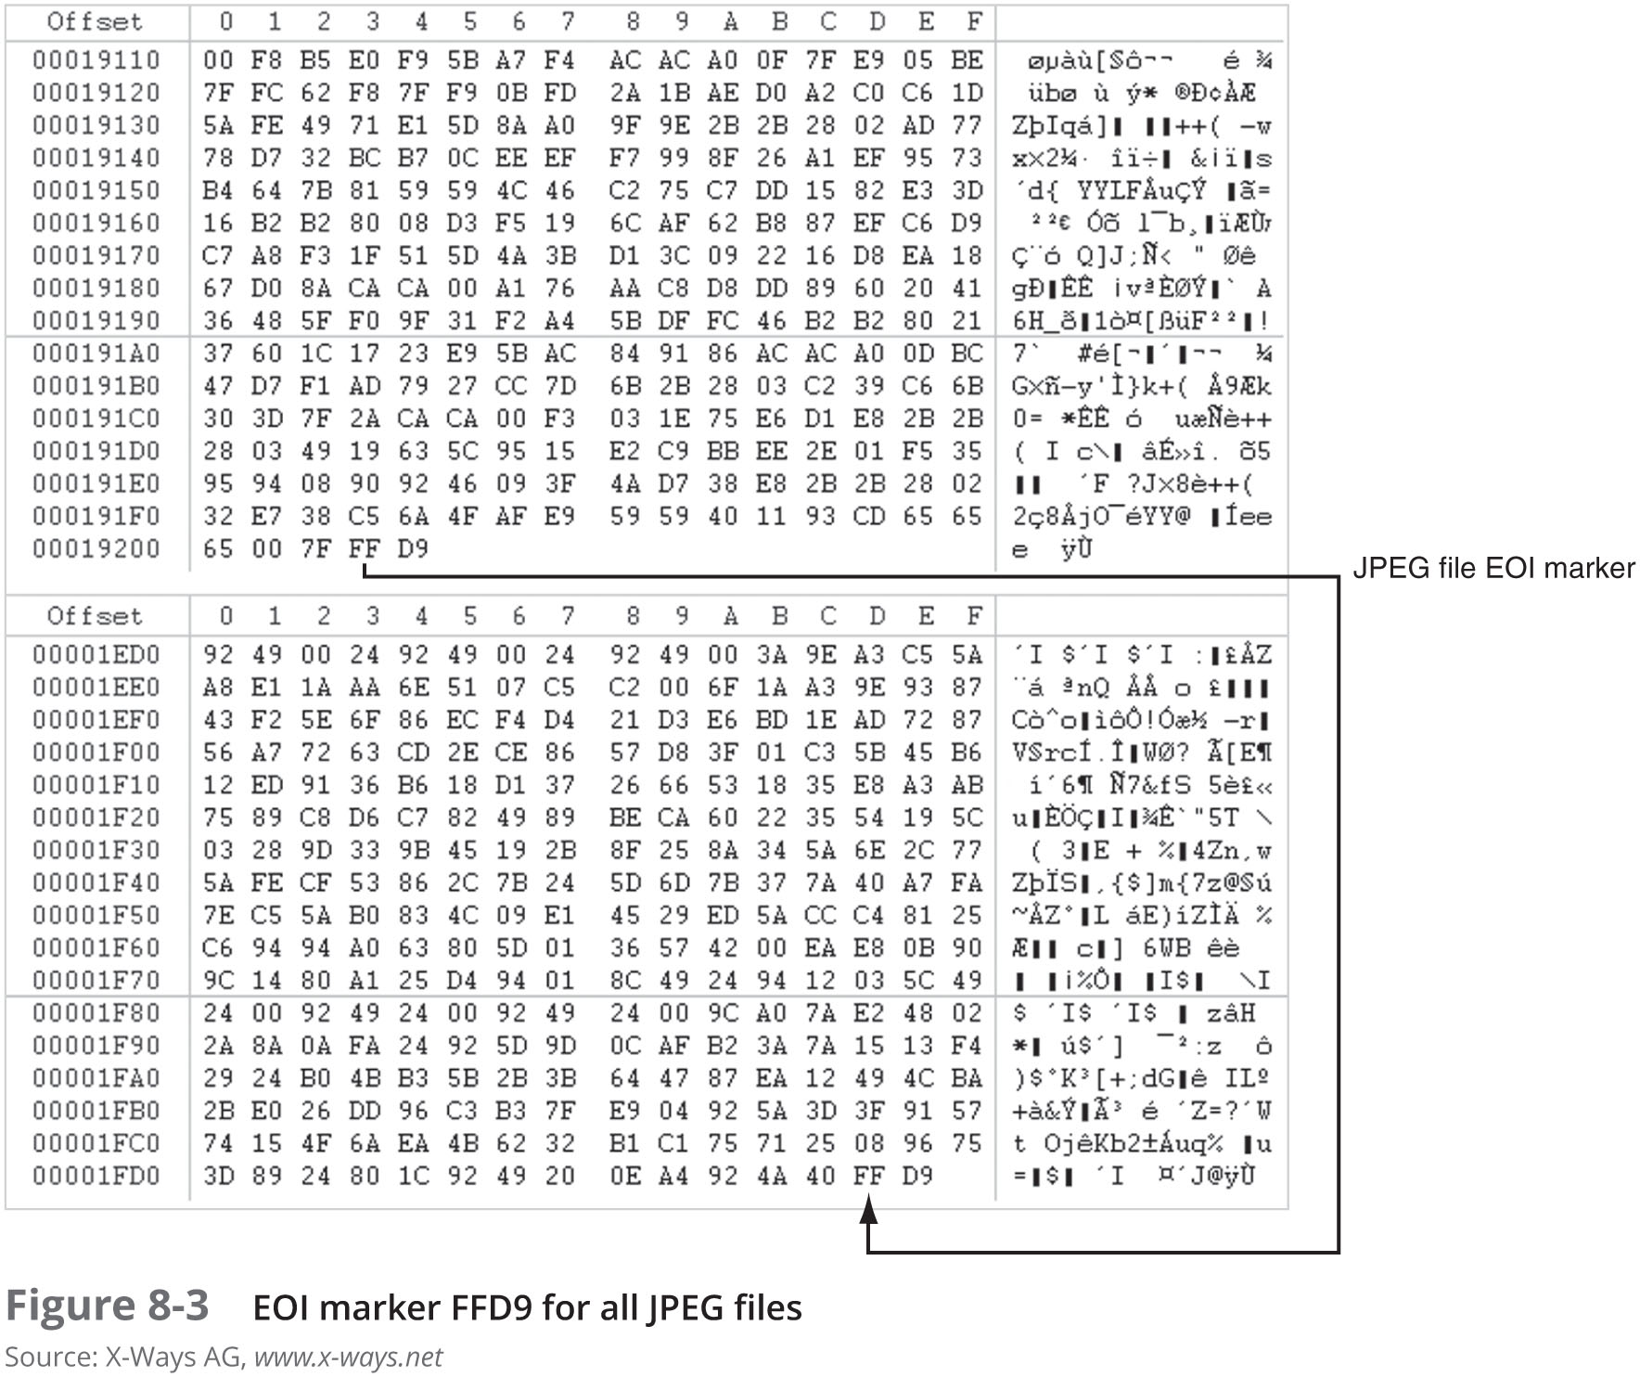
Understanding Digital Photograph File Formats (6 of 8)

Slide 15
Understanding Digital Photograph File Formats (7 of 8)
Examining the Exchangeable Image File format (cont’d)
With tools such as Autopsy and Exif Reader
You can extract metadata as evidence for your case

Slide 16
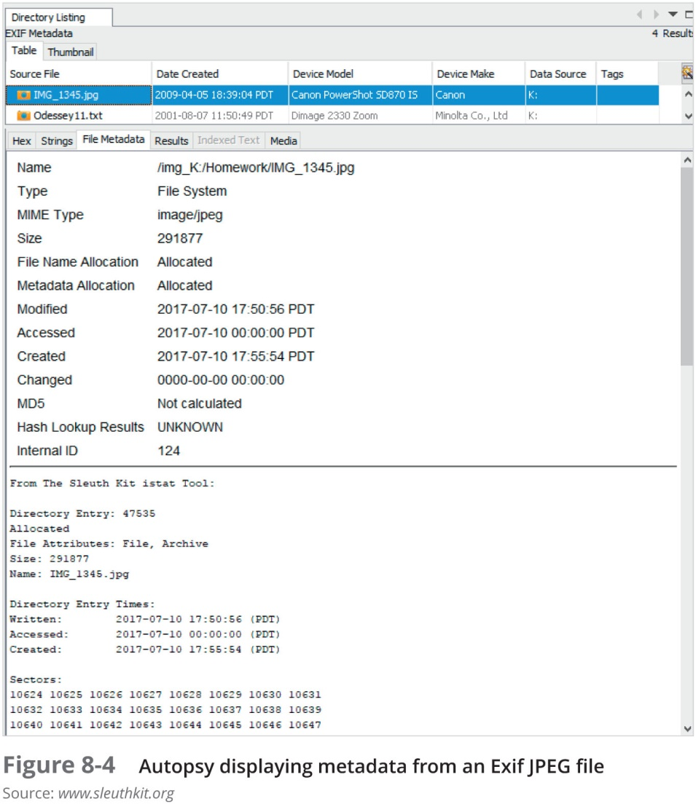
Understanding Digital Photograph File Formats (8 of 8)

Slide 17
Understanding Data Compression
Most graphics file formats compress their data
GIF and JPEG
Others, like BMP, do not compress their data
Use data compression tools for those formats
Data compression
Coding data from a larger to a smaller form
Types
Lossless compression and lossy compression

Slide 18
Lossless and Lossy Compression
Lossless compression
Reduces file size without removing data
Based on Huffman or Lempel-Ziv-Welch coding
For redundant bits of data
Utilities: WinZip, PKZip, StuffIt, and FreeZip
Lossy compression
Permanently discards bits of information
Vector quantization (VQ)
Determines what data to discard based on vectors in the graphics file
Utility: Lzip

Slide 19
Locating and Recovering Graphics Files
Operating system tools
Time consuming
Results are difficult to verify
Digital forensics tools
Image headers
Compare them with good header samples
Use header information to create a baseline analysis
Reconstruct fragmented image files
Identify data patterns and modified headers

Slide 20
Identifying Graphics File Fragments
Carving or salvaging
Recovering any type of file fragments
Digital forensics tools
Can carve from file slack and free space
Help identify image files fragments and put them together

Slide 21
Repairing Damaged Headers (1 of 4)
When examining recovered fragments from files in slack or free space
You might find data that appears to be a header
If header data is partially overwritten, you must reconstruct the header to make it readable
By comparing the hexadecimal values of known graphics file formats with the pattern of the file header you found

Slide 22
Repairing Damaged Headers (2 of 4)
Each graphics file has a unique header value
Example:
A JPEG file has the hexadecimal header value FFD8, followed by the label JFIF for a standard JPEG or Exif file at offset 6
Exercise:
Investigate a possible intellectual property theft by a new employee of Superior Bicycles, Inc.

Slide 23

Repairing Damaged Headers (3 of 4)

Slide 24
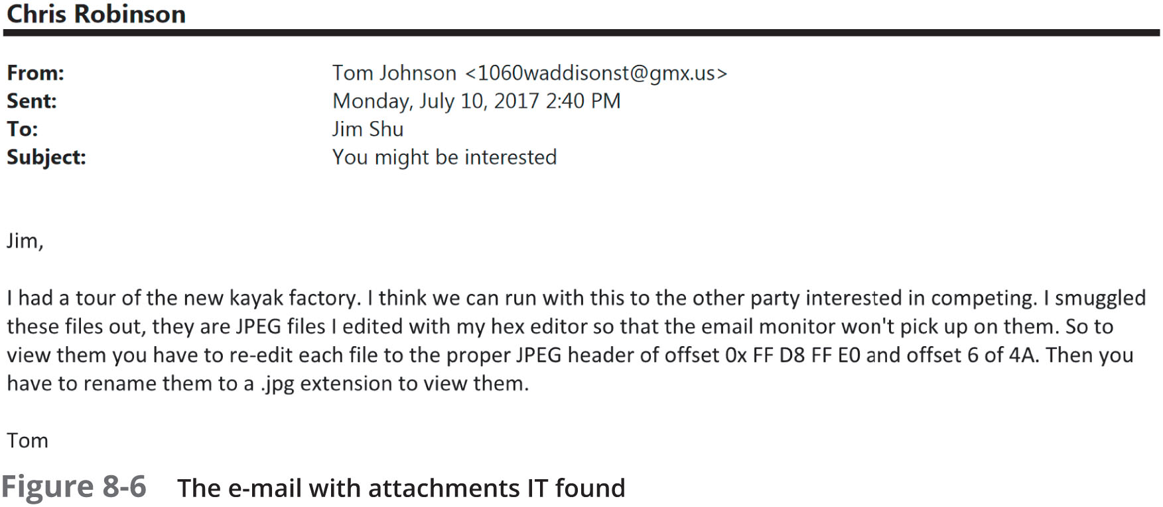
Repairing Damaged Headers (4 of 4)

Slide 25
Searching for and Carving Data from Unallocated Space (1 of 6)
Steps
Planning your examination
Searching for and recovering digital photograph evidence
Use Autopsy for Windows to search for and extract (recover) possible evidence of JPEG files
False hits are referred to as false positives

Slide 26
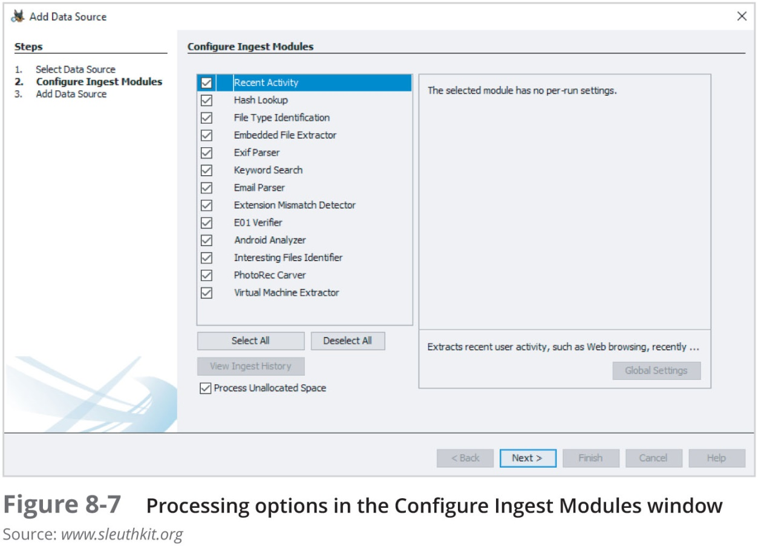
Searching for and Carving Data from Unallocated Space (2 of 6)

Slide 27
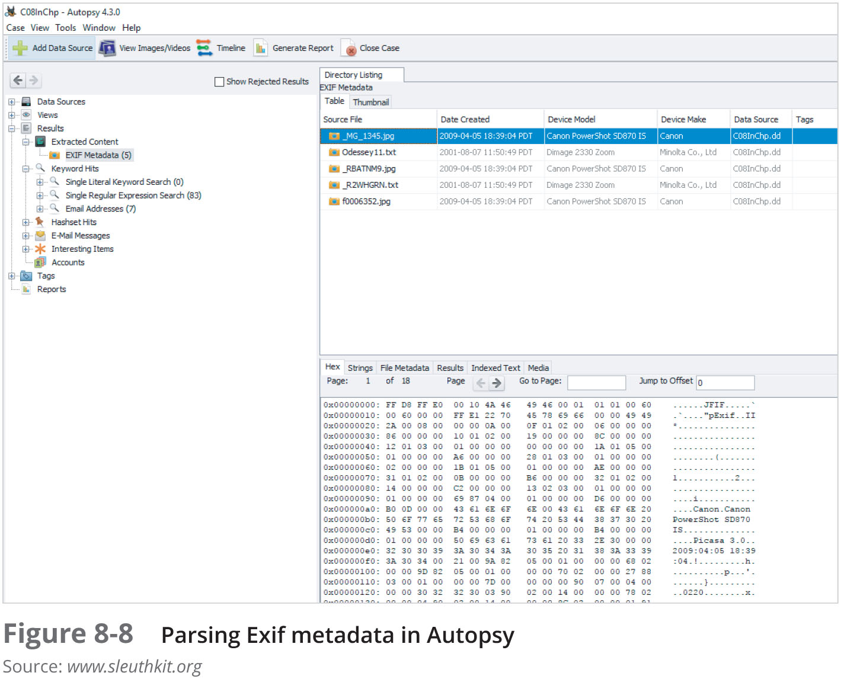
Searching for and Carving Data from Unallocated Space (3 of 6)

Slide 28
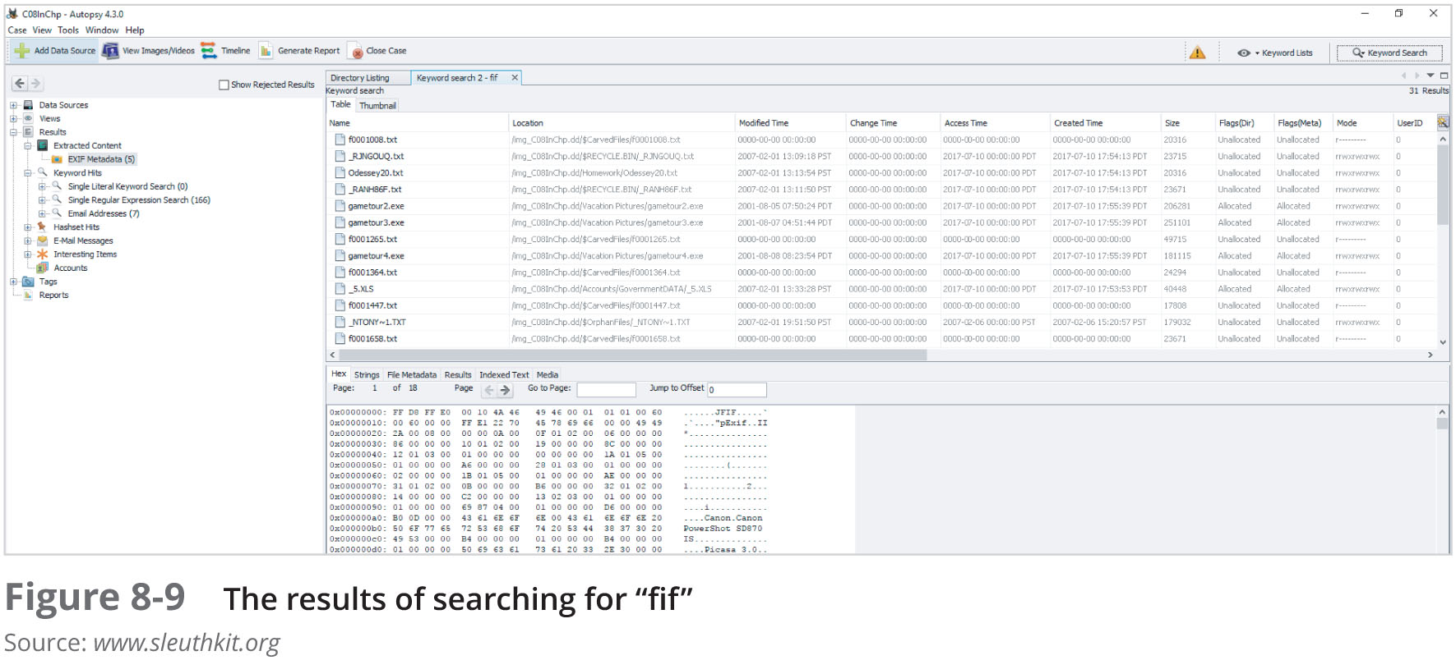
Searching for and Carving Data from Unallocated Space (4 of 6)

Slide 29
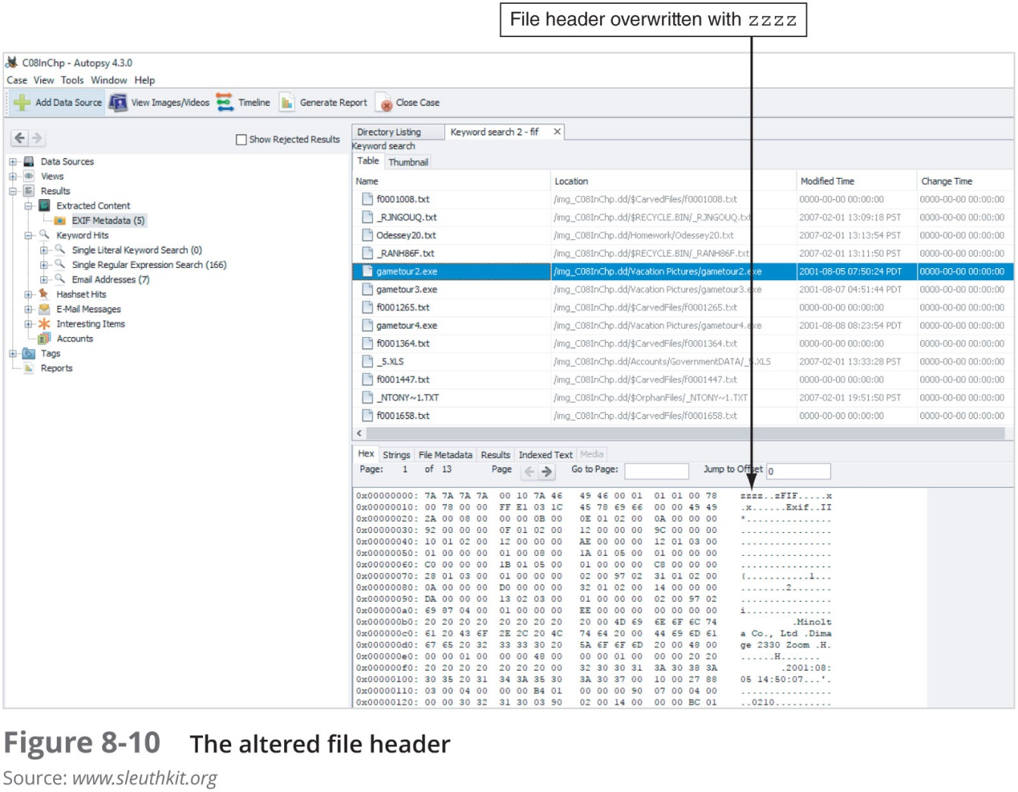
Searching for and Carving Data from Unallocated Space (5 of 6)

Slide 30
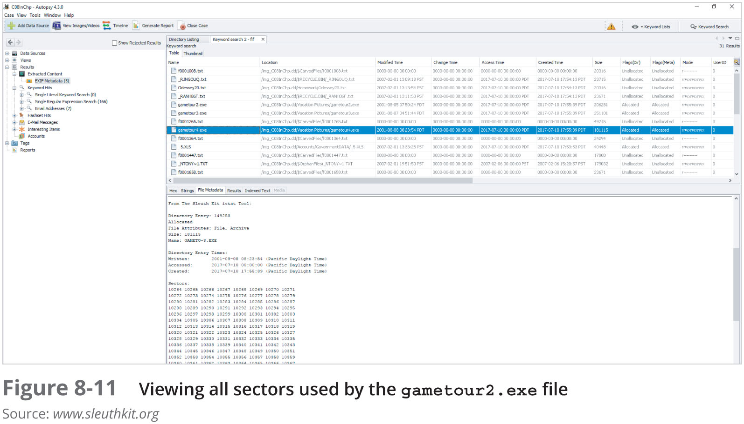
Searching for and Carving Data from Unallocated Space (6 of 6)

Slide 31
Rebuilding File Headers (1 of 6)
Before attempting to edit a recovered graphics file
Try to open the file with an image viewer first
If the image isn’t displayed, you have to inspect and correct the header values manually
Steps
Recover more pieces of file if needed
Examine file header
Compare with a good header sample
Manually insert correct hexadecimal values
Test corrected file

Slide 32
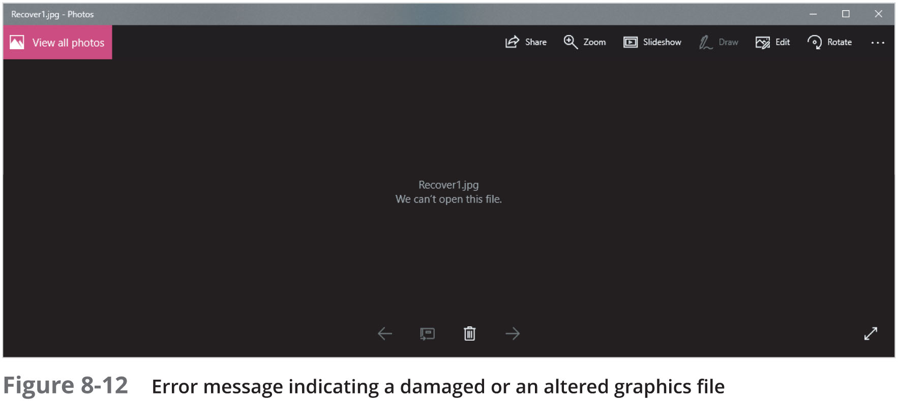
Rebuilding File Headers (2 of 6)

Slide 33
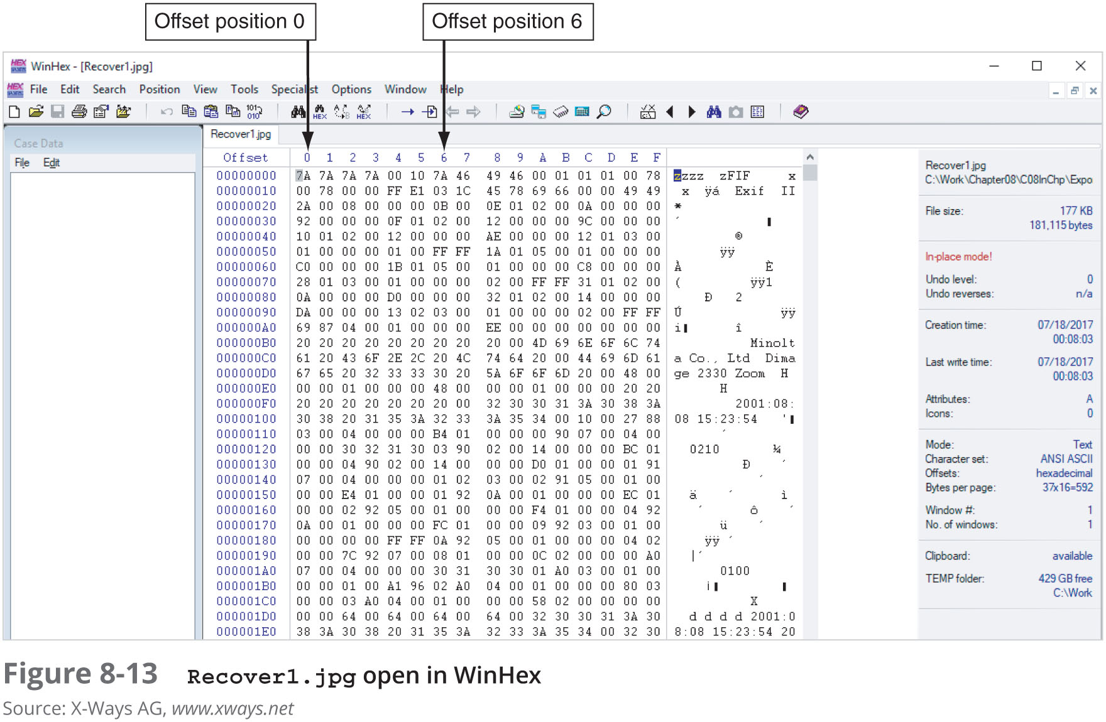
Rebuilding File Headers (3 of 6)

Slide 34
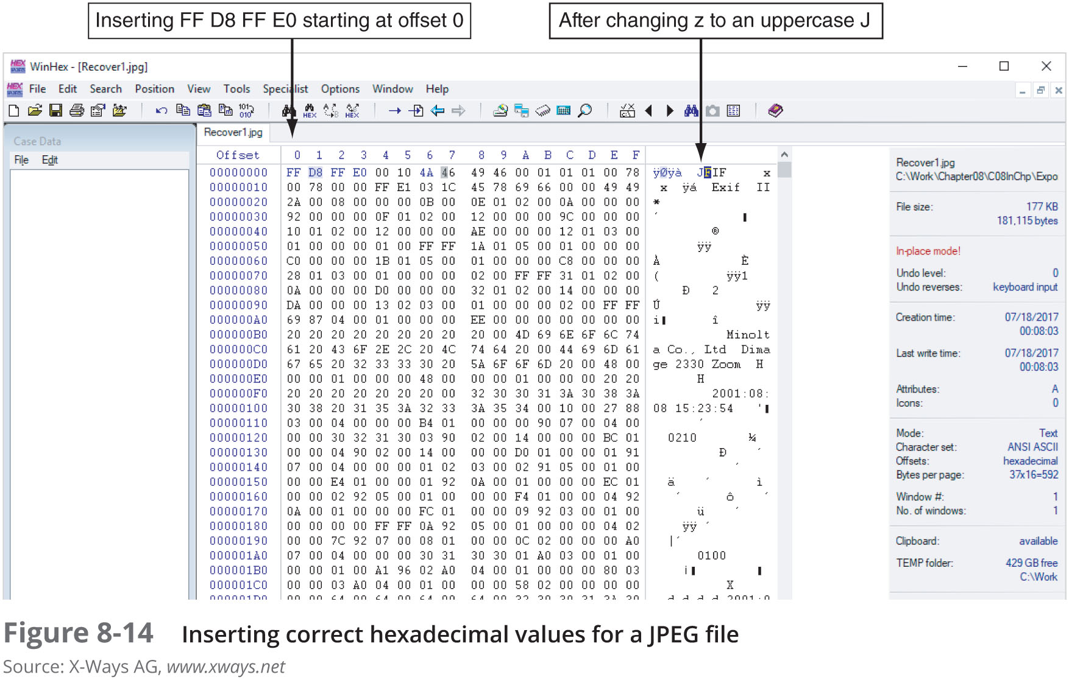
Rebuilding File Headers (4 of 6)

Slide 35
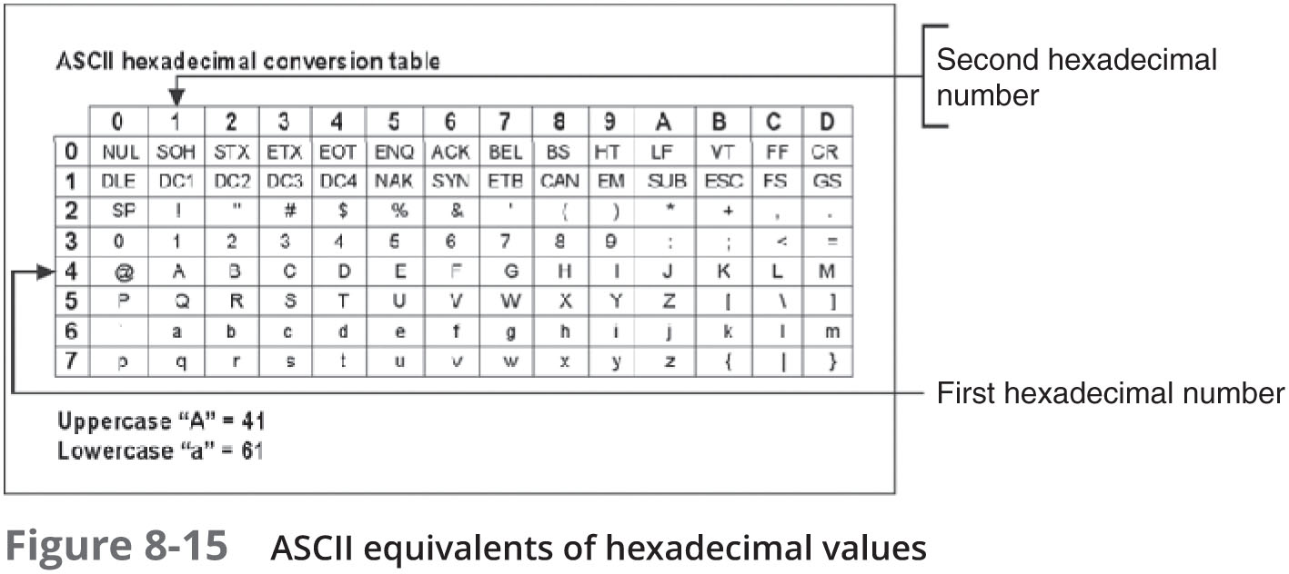
Rebuilding File Headers (5 of 6)

Slide 36
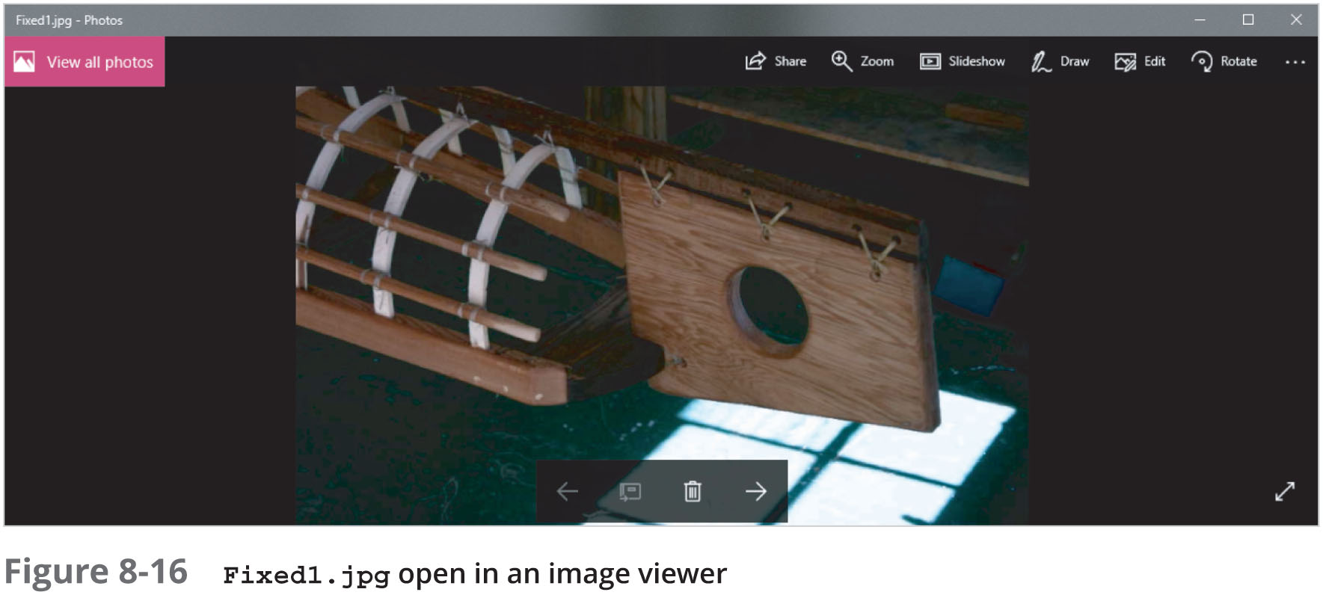
Rebuilding File Headers (6 of 6)

Slide 37
Reconstructing File Fragments
Locate the noncontiguous clusters that make up a deleted file
Steps
Locate and export all clusters of the fragmented file
Determine the starting and ending cluster numbers for each fragmented group of sectors
Copy each fragmented group of sectors in their correct sequence to a recovery file
Rebuild the file’s header to make it readable in a graphics viewer
Add a .txt extension on all the copied sectors
For larger files
Save as fragment1.txt (with header), fragment2.txt
Combine file type fragment2.txt >> fragment1.txt
ren fragment1.txt fixed.jpg

Slide 38
Identifying Unknown File Formats
Knowing the purpose of each format and how it stores data is part of the investigation process
The Internet is the best source
Search engines
Find explanations and viewers
Popular Web sites
FileFormat.info
Extension Informer
The Graphics File Formats Page

Slide 39
Analyzing Graphics File Headers (1 of 3)
Necessary when you find files your tools do not recognize
Use a hexadecimal editor such as WinHex
Record hexadecimal values in the header and use them to define a file type
Example:
XIF file format is old, little information is available
The first 3 bytes of an XIF file are the same as a TIF file
Build your own header search string

Slide 40
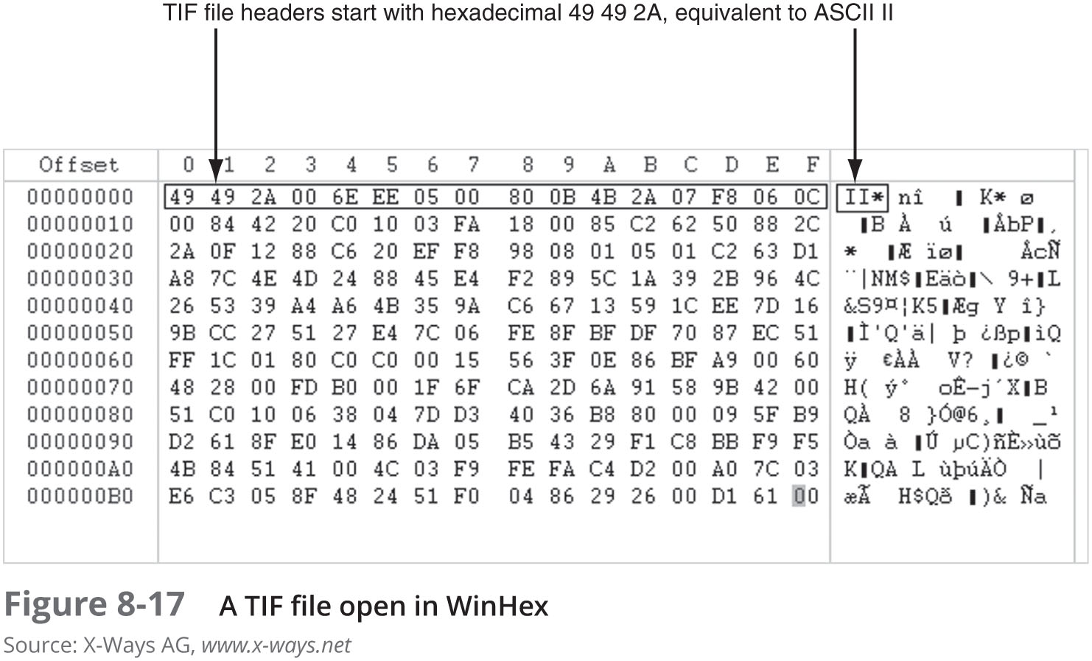
Analyzing Graphics File Headers (2 of 3)

Slide 41
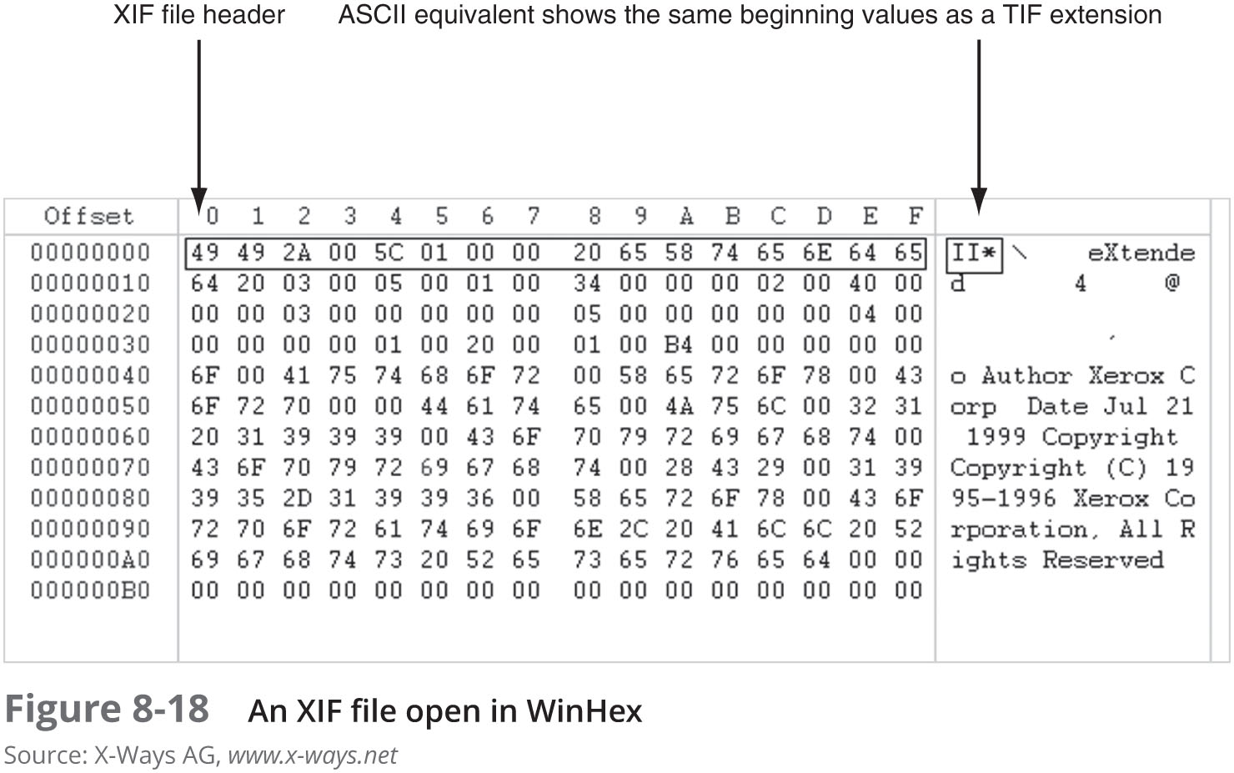
Analyzing Graphics File Headers (3 of 3)

Slide 42
Tools for Viewing Images
After recovering a graphics file
Use an image viewer to open and view it
No one viewer program can read every file format
Having many different viewer programs is best
Most GUI forensics tools include image viewers that display common image formats
Be sure to analyze, identify, and inspect every unknown file on a drive

Slide 43
Understanding Steganography in Graphics Files (1 of 7)
Steganography hides information inside image files
An ancient technique
Two major forms: insertion and substitution
Insertion
Hidden data is not displayed when viewing host file in its associated program
You need to analyze the data structure carefully
Example: Web page

Slide 44
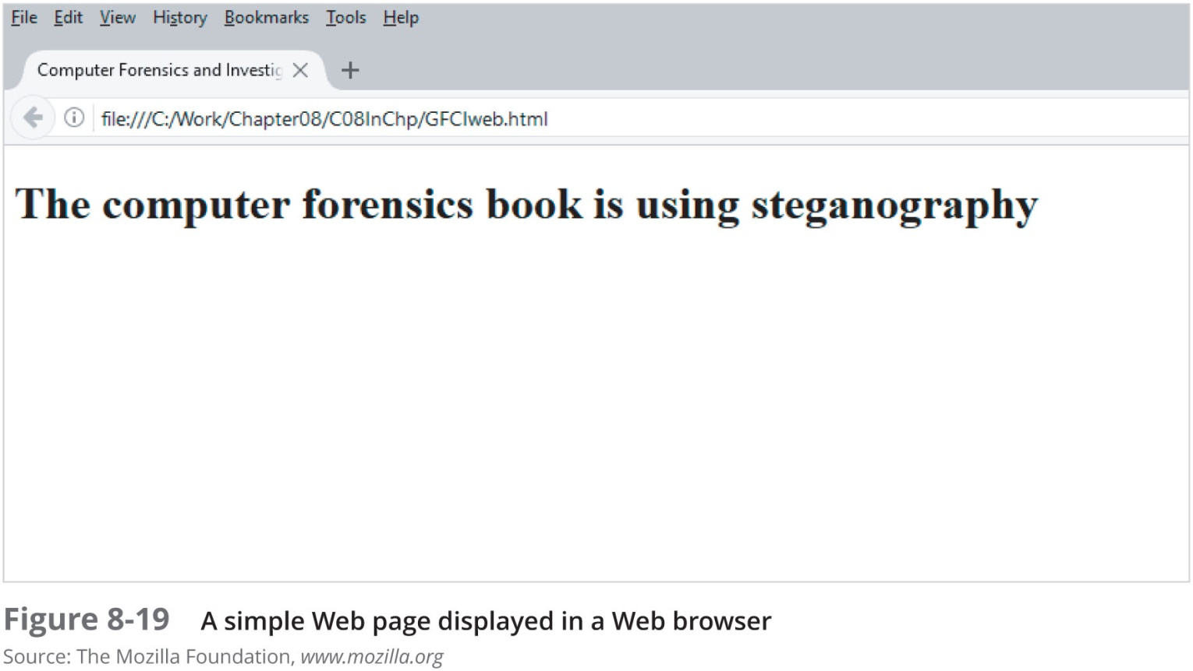
Understanding Steganography in Graphics Files (2 of 7)

Slide 45
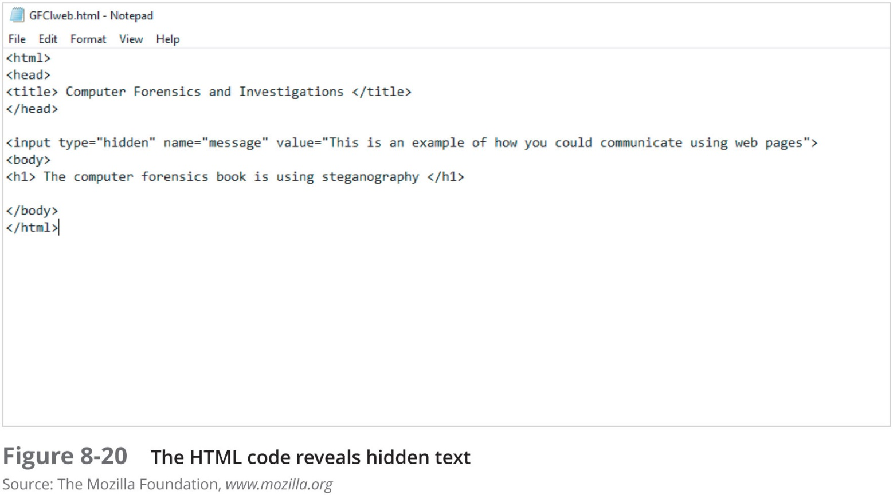
Understanding Steganography in Graphics Files (3 of 7)

Slide 46
Understanding Steganography in Graphics Files (4 of 7)
Substitution
Replaces bits of the host file with other bits of data
Usually change the last two LSBs (least significant bit)
Detected with steganalysis tools (a.k.a - steg tools)
You should inspect all files for evidence of steganography
Clues to look for:
Duplicate files with different hash values
Steganography programs installed on suspect’s drive

Slide 47
Understanding Steganography in Graphics Files (5 of 7)
Table 8-1 | Bit breakdown of a secret message
Original Pixel | Altered Pixel
1010 1010 | 1010 1001
1001 1101 | 1001 1110
1111 0000 | 1111 0011
0011 1111 | 0011 1100

Slide 48
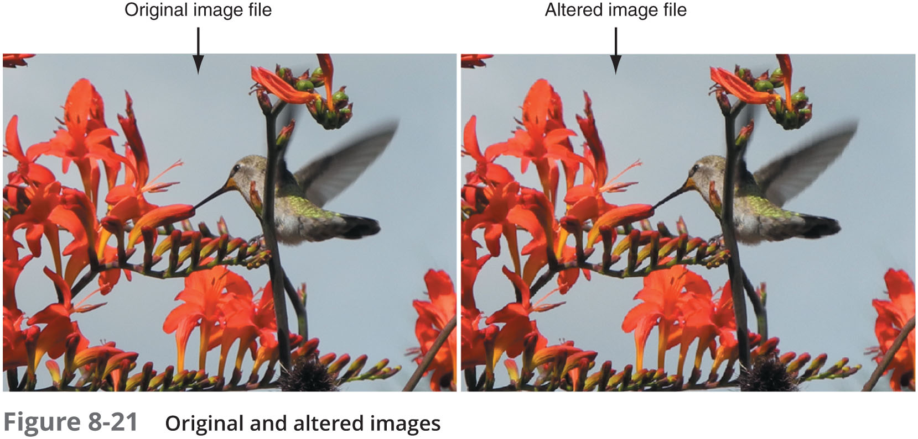
Understanding Steganography in Graphics Files (6 of 7)

Slide 49
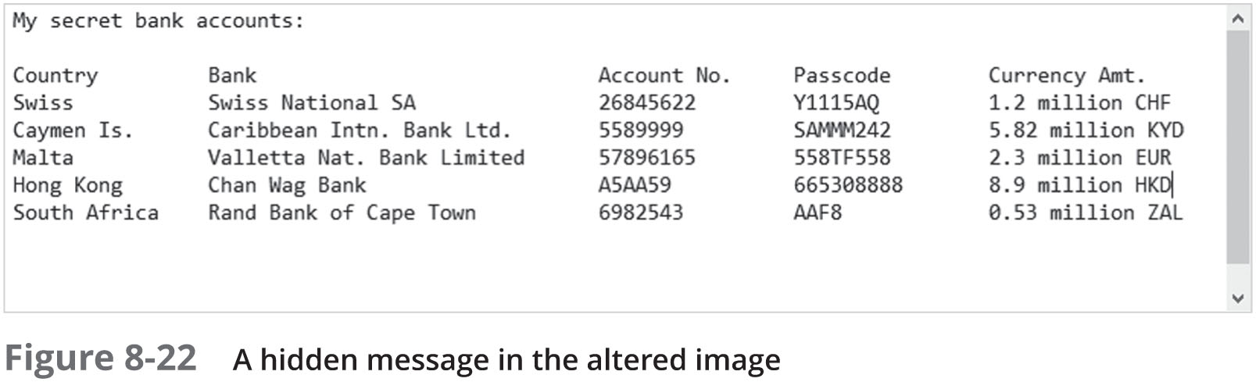
Understanding Steganography in Graphics Files (7 of 7)

Slide 50
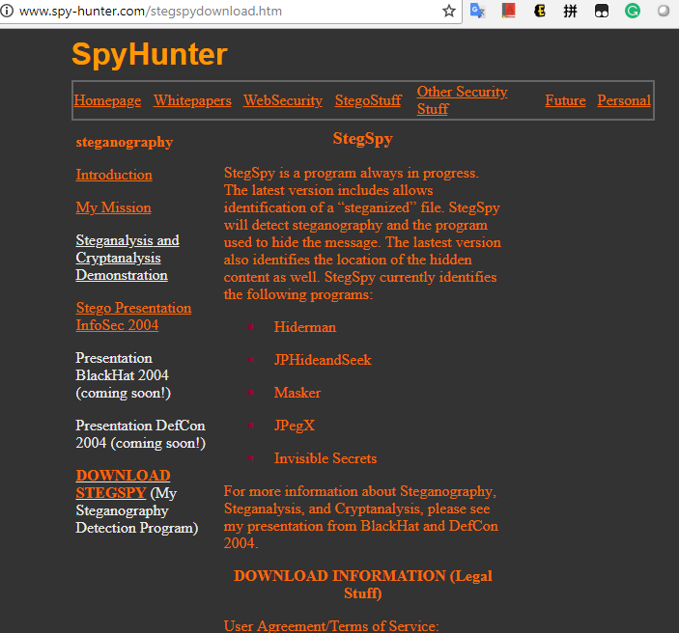
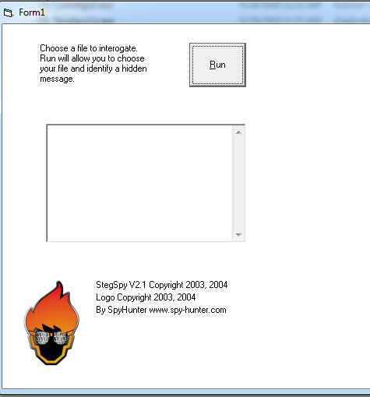
Using Steganalysis Tools
Use steg tools to detect, decode, and record hidden data
Detect variations of the graphic image
When done correctly you cannot detect hidden data in most cases
Check to see whether the file size, image quality, or file extensions have changed

Slide 51
Understanding Copyright Issues with Graphics
Steganography has been used to protect copyrighted material
By inserting digital watermarks into a file
Digital investigators need to aware of copyright laws
Copyright laws for Internet are not clear
There is no international copyright law
Check the U.S. Copyright Office
U.S. Copyright Office identifies what can and can’t be covered under copyright law in U.S.
Fair use
Another guideline to consider

Slide 52
Summary (1 of 3)
Three types of graphics files
Bitmap
Vector
Metafile
Image quality depends on various factors
Standard file formats: .gif, .jpeg, .bmp, and .tif
Nonstandard file formats: .tga, .rtl, .psd, and .svg
Some image formats compress their data
Lossless compression
Lossy compression

Slide 53
Summary (2 of 3)
Digital camera photos are typically in raw and EXIF JPEG formats
Recovering image files
Carving file fragments
Rebuilding image headers
The Internet is best for learning more about file formats and their extensions
Software
Image editors
Image viewers

Slide 54
Summary (3 of 3)
Steganography
Hides information inside image files
Forms
Insertion
Substitution
Steganalysis
Finds whether image files hide information
Fair use allows using copyrighted material for noncommercial or educational purposes without having to compensate the material’s originator or owner

